Slide 1
Topic 10 Multi-Area OSPF V1.0
TNE20002/TNE70003
Notes:
8.1 Multiarea OSPF Operation

Slide 2
Why Multi-Area OSPF?
Single-area OSPF is useful in smaller networks.
If an area becomes too large (Cisco state an area should have no more than 50 routers), the following issues must be addressed:
Large routing table
Large link-state database (LSDB)
Frequent SPF algorithm calculations
Notes:
8.1.1.1 Single-Area OSPF

Slide 3
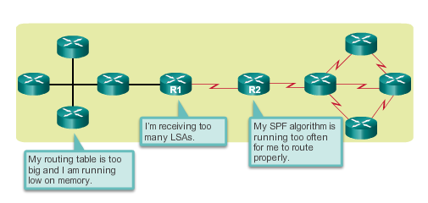
Why Multi-Area OSPF?
Single Area 0

Slide 4
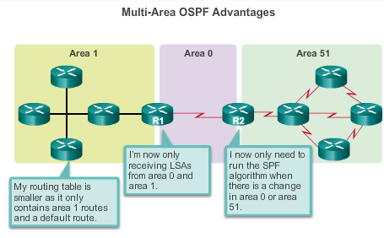
Multi-Area OSPF
Regular
Backbone
Regular
Notes:
8.1.1.2 Multiarea OSPF

Slide 5
OSPF Two-Layer Area Hierarchy
Multiarea OSPF is implemented in a two-layer area hierarchy:
Backbone (transit) area
Area whose primary function is the fast and efficient movement of IP packets.
Called OSPF area 0, to which all other areas directly connect.
Regular (non backbone) area
Connects users and resources.
A regular area does not allow traffic from another area to use its links to reach other areas.
Notes:
8.1.1.3 OSPF Two-Layer Area Hierarchy

Slide 6
Multi-Area OSPF
Regular
Backbone
Regular
Notes:
8.1.1.2 Multiarea OSPF

Slide 7
Types of OSPF Routers
Internal Router
Backbone Router
Area Border Router (ABR)
Autonomous System Boundary Router (ASBR)
A router can have multiple roles

Slide 8
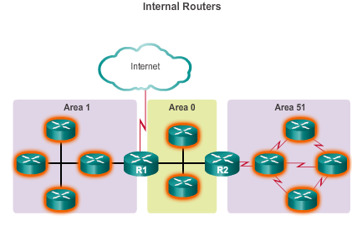
Types of OSPF Routers - Internal
All interfaces in the same area
All routers within the same area have identical LSDBs
External Autonomous System
Notes:
8.1.1.4 Types of OSPF Routers

Slide 9
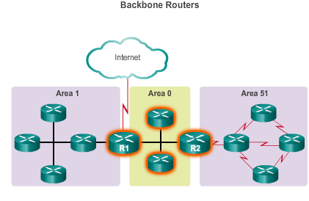
Types of OSPF Routers - Backbone
Routers that sit within the perimeter of backbone area 0 and
have at least one interface connected to area 0
External Autonomous System
Notes:
8.1.1.4 Types of OSPF Routers

Slide 10
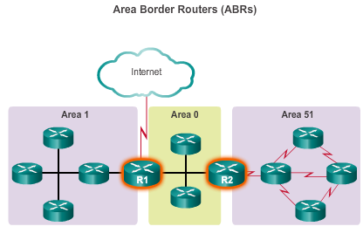
Types of OSPF Routers – Area Border
Routers that have interfaces attached to multiple areas
Maintain separate LSDBs for each area, and route traffic between areas
R1iR1
R1ttt
External Autonomous System
Notes:
8.1.1.4 Types of OSPF Routers

Slide 11
Types of OSPF Routers – Area Border
ABRs connect area 0 to a non backbone area
Are exit points for an area
Routing information destined for another area can get there only via the ABR of the local area
ABRs distribute routing information into backbone
Backbone routers forward routing information to other ABRs
ABRs are the only point where address summarization can be configured, to summarize the routing information from the LSDBs of their attached areas
Notes:
8.1.1.3 OSPF Two-Layer Area Hierarchy

Slide 12
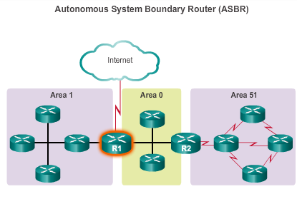
Types of OSPF Routers – Autonomous System Boundary
Routers that have at least one interface attached
to a different routing domain eg EIGRP
EIGRP
External Autonomous System
Notes:
8.1.1.4 Types of OSPF Routers

Slide 13
Types of OSPF Routers – Autonomous System Boundary
Different Routing Domains
A domain using EIGRP
ASBRs can redistribute external EIGRP routes into the OSPF domain
Notes:
8.1.1.3 OSPF Two-Layer Area Hierarchy

Slide 14
Types of OSPF Routers
Internal Router
All interfaces in the same area
Backbone Router
Routers that sit within the perimeter of backbone area 0 and have at least one interface connected to area 0
Area Border Router (ABR)
Routers that have interfaces attached to multiple areas
Autonomous System Boundary Router (ASBR)
Routers that have at least one interface attached to a different routing domain eg EIGRP

Slide 15
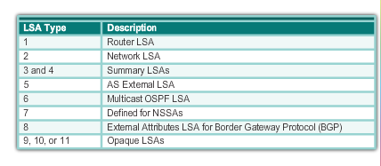
OSPF LSA (Link State Advertisement) Types
The building blocks of OSPF, Only 1 to 5,
will be covered
Notes:
8.1.2.1 OSPF LSA Types

Slide 16
Type 1 - Router LSA
Every router generates Type 1 LSAs for each area to which it belongs
Describes the states of the router’s links to the other routers in the area and are flooded only within a particular area
Notes:
Chapter 8 Summary

Slide 17
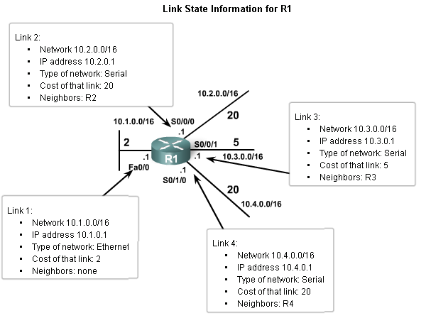
Type 1 - Router LSA

Slide 18
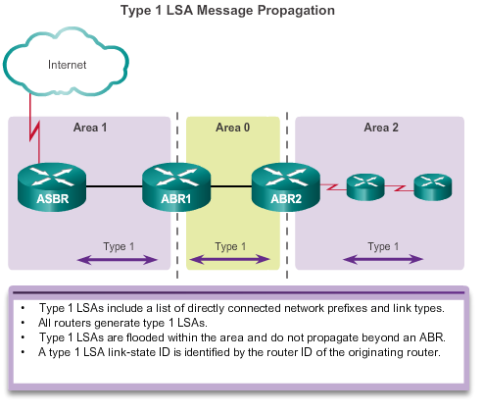
Type 1 - Router LSA
EIGRP External Autonomous System
Notes:
8.1.2.2 OSPF LSA Type 1

Slide 19
OSPF – Router ID
To use OSPF a Router must have a Router ID to identify the router within the OSPF network; it uses an IP address as its ID
Routers have multiple IP addresses, which one should be used?
Router ID is derived based on 3 criteria in order of precedence:
Configured using OSPF router-id command
If router-id command not used, router chooses highest IP address of any loopback interfaces.
If no loopback interfaces are configured, the highest IP address on any active interface is used

Slide 20
Type 2 - Network LSA – Multi Access Networks
DRs (Designated routers) generate Type 2 network LSAs for multi-access networks
Describe the set of routers attached to a particular multi-access network
Are not forwarded outside of an area
Notes:
Chapter 8 Summary

Slide 21
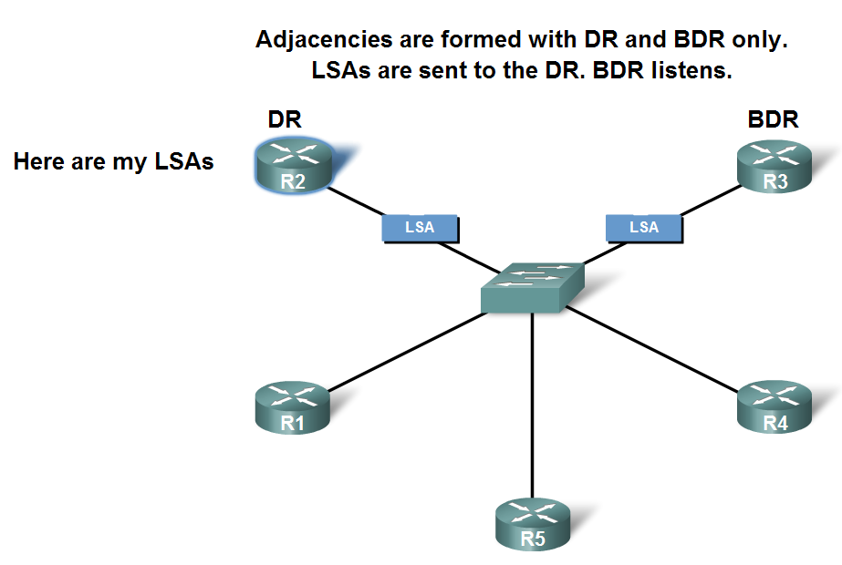

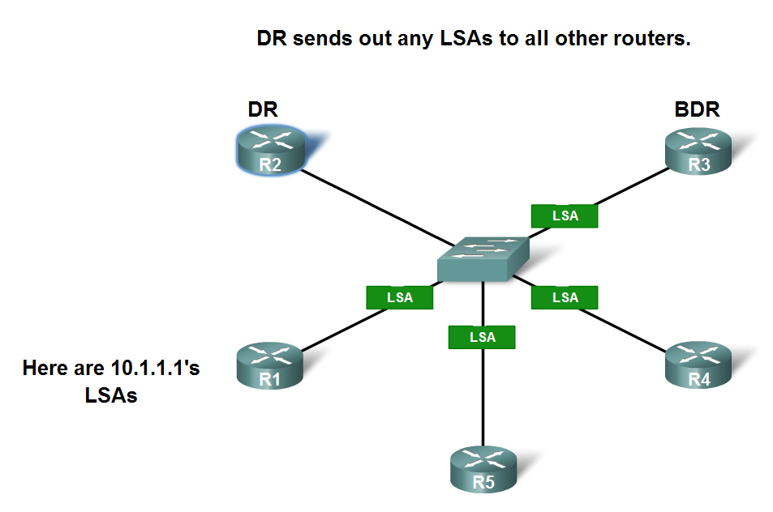
Type 2 - Network LSA – Multi Access Networks
Designated router (DR) and
Backup designated router (BDR)
Sending and Receiving LSAs
Router R1 sends Type 1 LSAs via multicast 224.0.0.6 to DR & BDR
DR sends Type 2 LSA via multicast address 224.0.0.5 to DRothers (all other routers)
Type 1 From R1
DRothers
Type 2 From DR

Slide 22
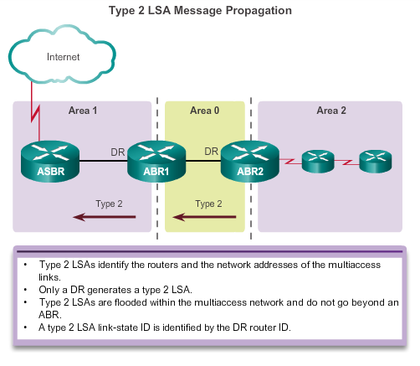
Operation OSPF LSA Type 2
Network
Multi-access links
Serial links
External Autonomous System
Notes:
8.1.2.3 OSPF LSA Type 2

Slide 23
How do we Learn about networks in other Areas?
Type 3 Summary LSA
Type 4 Summary LSA
ABRs are the only point where address summarization can be configured, to summarize the routing information from the LSDBs of there attached areas
Do not cause a router to run SPF algorithm

Slide 24
Type 3 - Summary LSA
Describe interarea routes
Describe routes to an area’s networks, may include summary routes, are created and generated by ABR.
Notes:
Chapter 8 Summary

Slide 25
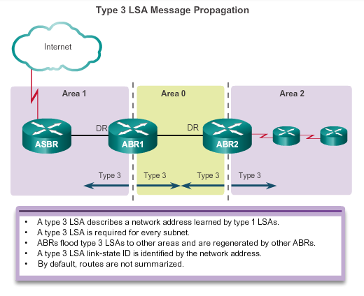
OSPF LSA Type 3
Summary
EIGRP External Autonomous System
Multi-access links
Serial links
Type 1
Notes:
8.1.2.4 OSPF LSA Type 3

Slide 26
Type 3 - Summary LSA
An Area Border Router (ABR) takes information it has learned on one of its attached areas and summarizes it before sending it out to other areas it is connected to
This summarization provides scalability by removing detailed topology information for other areas, because their routing information is summarized into just an network address, prefix and cost.

Slide 27
Type 4 – ASBR Summary LSA
Is generated by an ABR only when an Autonomous System Boundary Router exists within an area.
Provides the route to the ASBR (Router), to routers in other areas
.
Notes:
Chapter 8 Summary

Slide 28
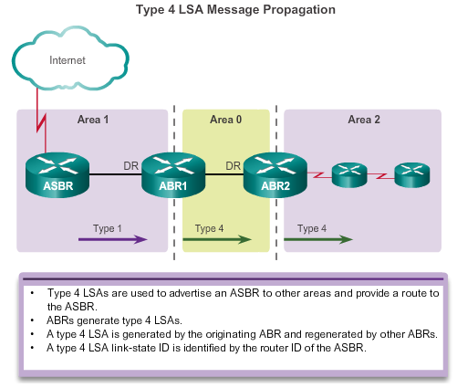
Multiarea OSPF LSA Operation OSPF LSA Type 4
Summary
EIGRP External Autonomous System
Multi-access links
Serial links
Learned from Type 1
Notes:
8.1.2.5 OSPF LSA Type 4

Slide 29
Type 5 - Autonomous System External LSA
Describe routes to networks outside the OSPF autonomous system.
Generated by the ASBR and are flooded to the entire autonomous system.
Notes:
Chapter 8 Summary

Slide 30
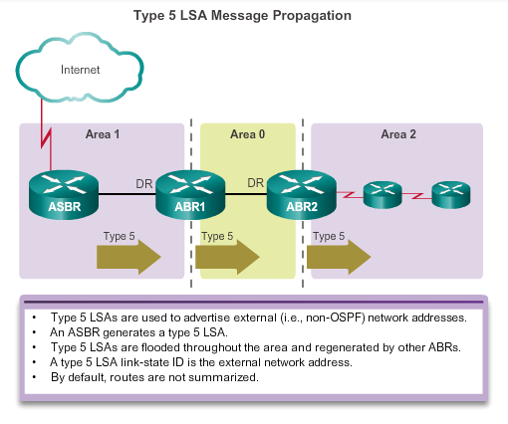
OSPF LSA Type 5
External
Multi-access links
Serial links
EIGRP External Autonomous System
Notes:
8.1.2.6 OSPF LSA Type 5

Slide 31
OSPF – Steps to Convergence
Calculate Intra Area OSPF Routes
All routers via LSAs type 1 and 2,
calculate via SPF algorithm
the least cost paths to destinations
within their area (intra-area)
and add these entries to the routing table.
Designator O in routing table
Notes:
8.1.3.2 OSPF Route Calculation

Slide 32
OSPF – Steps to Convergence
Inter Area OSPF Routes
All routers via LSAs type 3 and 4
receive the least cost paths to the
networks in other areas
within the internetwork (inter-area) .
Designator O IA in routing table
Notes:
8.1.3.2 OSPF Route Calculation

Slide 33
OSPF – Steps to Convergence
OSPF Routes to External Non OSPF Networks
All routers via LSA type 5,
receive the least paths to the external
autonomous system destinations.
Designator O E2 in routing table
Notes:
8.1.3.2 OSPF Route Calculation

Slide 34
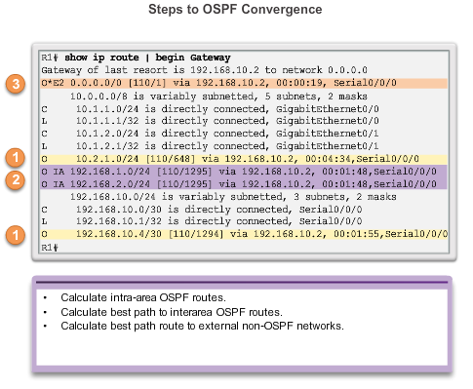
OSPF – 3 Steps to Convergence – Routing Table
1
Calculate via SPF least cost paths to intra-area routes
Insert least cost paths to inter-area networks
Insert least cost paths to external non-OSPF networks
2
3
Notes:
8.1.3.2 OSPF Route Calculation

Slide 35
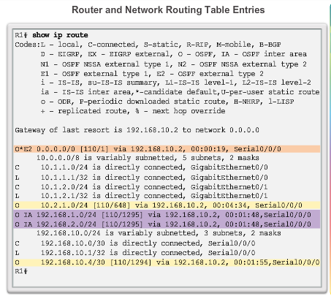
OSPF Routing Table Entries
O – Router describe the details within an area (the route is intra-area).
O IA – Summary inter-area routes
O E2 – External routes
Notes:
E1 or External Type Routes – The cost of E1 routes is the cost of the external metric with the additional of the internal cost within OSPF to reach that network. ... Basically difference between E1 and E2 is: E1 includes – internal cost to ASBR added to external cost, E2 does not include – internal cost

Slide 36
OSPF Multi Area Explained - YouTube
The END

